Slide 1
RIP
Course Code: CSC 3116
Course Title: Computer Networks
Dept. of Computer Science
Faculty of Science and Technology
Lecturer No: | Lab 5 | Week No: | 5 | Semester: | Summer 22-23
Lecturer: | Shakila Rahman; Shakila.Rahman@aiub.edu

Slide 2
Lecture Outline
Introduction
Static routing vs dynamic routing
Dynamic routing
Routing information protocol (RIP)

Slide 3
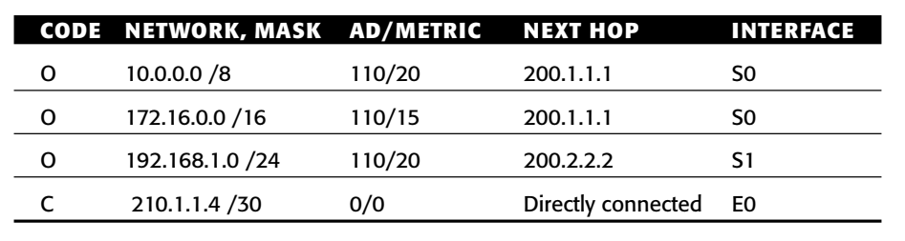
Introduction
Routing
routing is the act of forwarding network packets from a source
network to a destination networks by a router based on its routing table [2].
Fig. A simplified routing table [2]

Slide 4
Introduction
How is the routing table created?
Static routing
If it is done manually by inputting information for each destination network by a network engineer,
Suitable for very small network
Dynamic routing
If the table is created and modified automatically depending on the network condition by a routing protocol
Dynamic routing can be deployed on small to large size network.

Slide 5
Dynamic Routing
Features
Facilitates the exchange of routing information between routers
Allow routers to dynamically learn information about remote networks and automatically add this information to their own routing tables
Determines the best path to each network

Slide 6
Dynamic Routing….
Ways to classify routing protocols
Interior Gateway Protocols or Exterior Gateway protocols
Distance vector or Link state

Slide 7
Dynamic Routing….
IGP
IGP
Routing inside an autonomous system (AS), where, AS is a collection of network under a common administrator
Example
Routing Information Protocol (RIP) version 1
Interior Gateway Routing Protocol (IGRP)
Enhanced IGRP (EIGRP)
Open Shortest Path First (OSPF)
Intermediate System (IS)-IS

Slide 8
Dynamic Routing….
EGP
EGP
Routing between autonomous systems(AS)
Example
Border Gateway Protocol (BGP)

Slide 9
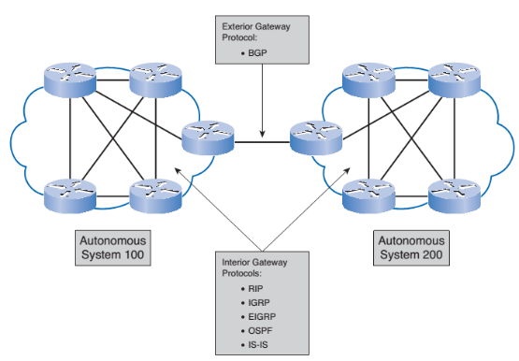
Dynamic Routing….
Classification
Autonomous systems
An autonomous system (AS) is a very large network or group of networks with a single routing policy.

Slide 10
Dynamic Routing….
Distance vector means that routes are advertised as vectors of distance and direction
Distance is defined in terms of a metric such as hop count, and direction is simply the next hop router or exit interface.
Bellman-Ford algorithm is used for the best-path route determination.
Some distance vector protocols periodically send complete routing tables to all connected neighbors.
In large networks, these routing updates can become enormous, causing significant traffic on the links.
Example
RIP, EIGRP
Distance vector means that routes are advertised as vectors of distance and direction
Distance is defined in terms of a metric such as hop count, and direction is simply the next hop router or exit interface.
Bellman-Ford algorithm is used for the best-path route determination.
Some distance vector protocols periodically send complete routing tables to all connected neighbors.
In large networks, these routing updates can become enormous, causing significant traffic on the links.
Example
RIP, EIGRP
Distance vector routing
A router communicates with its neighbors only for populating its routing table
Distance vector means that routes are advertised as vectors of distance and direction
Distance is defined in terms of a metric such as hop count, and direction is simply the next hop router or exit interface.
Bellman-Ford algorithm is used for the best-path route determination.
Some distance vector protocols periodically send complete routing tables to all connected neighbors.
In large networks, these routing updates can become enormous, causing significant traffic on the links.
Example
RIP, EIGRP

Slide 11
Dynamic Routing….
Link state routing
A router configured with a linkstate routing protocol can create a “complete view,” or topology, of the network by gathering information from all the other routers.
A router communicates with all other routers of the network
Only send update (partial) when there is any change in the network topology
Example
OSPF

Slide 12
Dynamic Routing….
Administrative Distance
The term trustworthiness is commonly used when defining administrative distance.
Administrative distance (AD) defines the preference of a routing source.
Administrative distance is an integer value from 0 to 255.
The lower the value, the more preferred the route source.
An administrative distance of 0 is the most preferred.
Only a directly connected network has an administrative distance of 0, which cannot be changed.

Slide 13
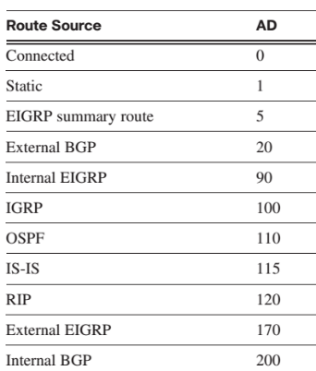
Dynamic Routing….
Administrative distance

Slide 14
RIP
Features
Distance vector routing protocol
Hop count is used as the metric for path selection.
If the hop count for a network is greater than 15, RIP cannot supply a route to that network.
Routing updates are broadcast or multicast every 30 seconds, by default.
If for some reason, an update for a particular route is not received within a period of 180 seconds then that specific route is declared as invalid and the router which identified that, informs all its neighbors about this invalid route.
Has two versions: RIPv1 & RIPv2

Slide 15
RIP
RIP v1-vs-RIPv2
Uses Classless addressing
RIPv1 uses classful addressing, RIPv2 uses VLSM
Multicasting vs Broadcasting
Version 1 of RIP uses broadcasting (to 255.255.255.255) to send RIP messages to every neighbor. In this way, all the routers on the network receive the packets, as well as the hosts. RIP version 2, on the other hand, uses the all-router multicast address (224.0.0.9) to send the RIP messages only to RIP routers in the network.
Updates
RIPv2 sends and receives version 2 updates only. RIPv1 sends version 1 updates and receives both 1 and 2, however version 2 information is ignored.
Authentication
RIPv2 ensure authentication, while RIPv1 does not

Slide 16
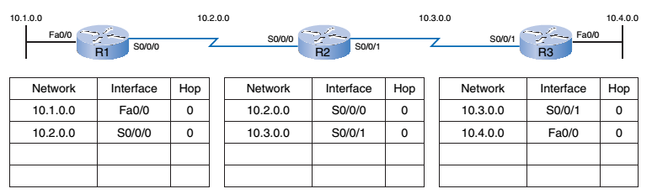
RIP
Routing table update
Cold Start

Slide 17
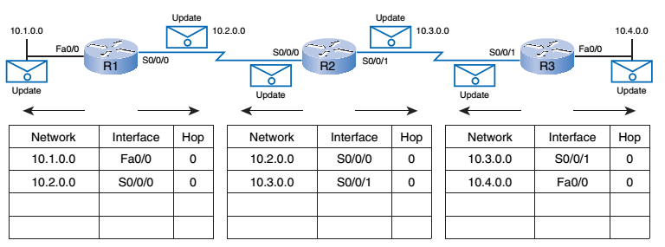
Topic Heading..
Routing table update
Initial Exchange of Information

Slide 18
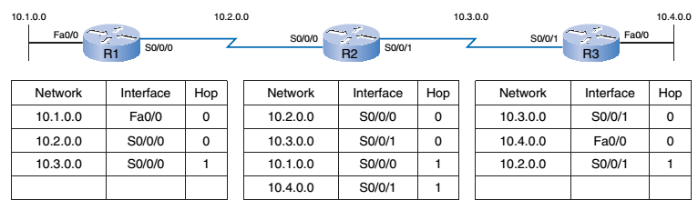
Topic Heading..
Routing table update
Table Updating

Slide 19
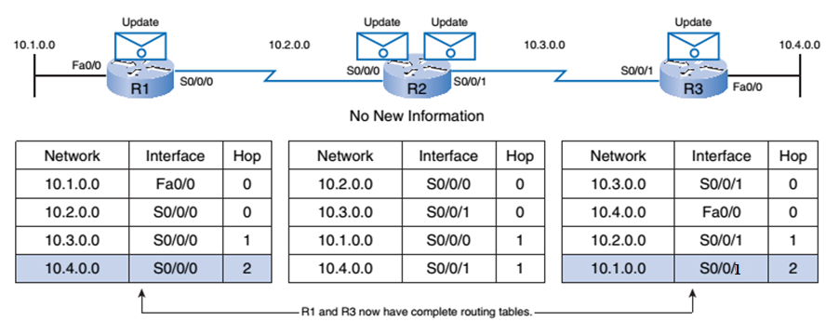
Topic Heading..
Routing table update
Next Update

Slide 20
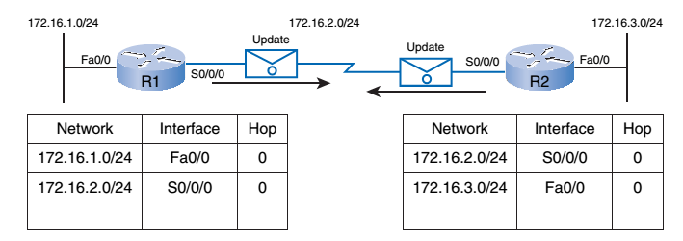
Topic Heading..
Another Example

Slide 21
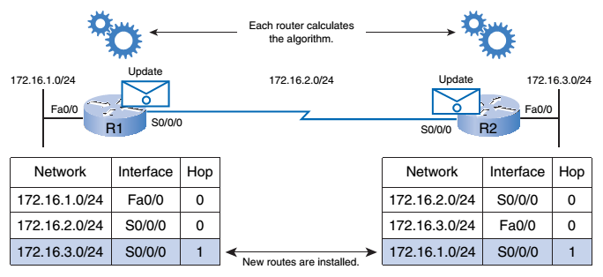
Topic Heading..
New route

Slide 22
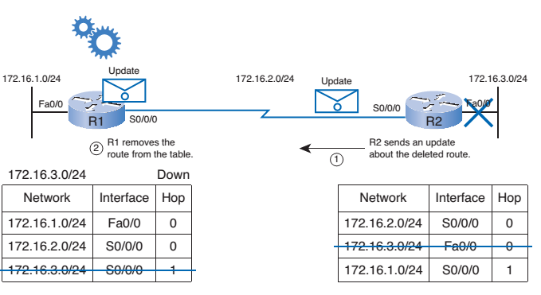
Topic Heading..
Removing a route

Slide 23

RIPv2 Configuration
172.16.1.0/30
192.168.2.0/24
172.16.1.4/30
IOS Commands
R1(config)# router rip
R1(config-router)# version 2
R1(config-router)#network 172.16.1.0
R1(config-router)#network 172.16.1.4
R1(config-router)#network 192.168.2.0
R1(config-router)#no auto-summary

Slide 24
RIPv2 Configuration
Trableshooting
172.16.1.0/30
192.168.2.0/24
172.16.1.4/30
To show protocol properties
show ip protocols
To show all routes
show ip route
To show all RIP activities in real-time
debug ip rip
To stop debugging
no debug all
To show RIP database
show ip rip database

Slide 25
References
[1] R. Graziani and A. Johnson, Routing Protocols and Concepts, 2nd ed.,
Cisco Systems, Inc., USA, 2008, pp. 148-173.
[2] J. Macfarlane, Network Routing Basics, Wiley Publications. Inc.,
2006, USA, pp. 70-104.

Slide 26
Books
1. Official Cert Guide CCNA 200-301 , vol. 1, W. Odom, Cisco Press, First Edition, 2019, USA.
2. CCNA Routing and Switching, T. Lammle, John Wily & Sons, Second Edition, 2016, USA.

